Slide 1

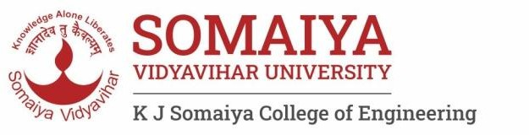

Computer Organization and Architecture
Div C SY COMP
Sem III
Snehal
AY 2024-25

Slide 2



Computer Organization and Architecture
Course Outcomes
At the end of successful completion of the course the student will be able to
CO 1. Describe and define the structure of a computer with buses
structure and detail working of the arithmetic logic unit and its sub modules
CO 2. Understand the Central processing unit with addressing modes and working of control unit in depth
CO 3. Learn and evaluate memory organization and cache structure
CO 4. Summarize Input output techniques and multiprocessor configurations

Slide 3
Module 1
Structure of a Computer System 1.1
Introduction of computer system and its sub modules,
Basic organization of computer and block level description of the functional units. Von Neumann model 1.2
Introduction to buses, bus types, and connection I/O devices to CPU and memory, PCI and SCSI

Slide 4
Recap : Types of Buses
Data Bus : Width of Data Operations
Address Bus : Memory Addressing Capability
Control Bus : Controls activities of all units of a computer
Main Function is to carry control signals generated by control unit –
Ex: One line of control bus is used to indicate whether the CPU is reading/writing to the main memory
Control and timing information
Memory read/write signal
Interrupt request
Clock signals

Slide 5
Types of Buses
Single Bus :
Lots of devices on one bus leads to:
Propagation delays
Long data paths mean that co-ordination of bus use can adversely affect performance
If aggregate data transfer approaches bus capacity
Most systems use multiple buses to overcome these problems
Dedicated – Separate data & address lines
Multiplexed – Shared lines
Address valid or data valid control line
Advantage - fewer lines
Disadvantages : More complex control

Slide 6
Types of Buses
Multiple Masters / Controllers on the Bus
Bus Arbitration
Only one module may control bus at one time
Centralized Arbitration
Single hardware device controlling bus access
Bus Controller
Arbiter
May be part of CPU or separate
Distributed Arbitration
Each module may claim the bus
Control logic on all modules

Slide 7
Types of Buses
PCI Bus
SCSI Bus
Busses Before that
ISA Bus 8 bit , 16 bit
Characteristics : parallel/ serial, synchronous / asynchronous
Meaning of Standards and Protocols
Data Transfer Rate

Slide 8
Features PCI Bus
PCI bus connects the CPU and expansion boards
Modem , Network Card , Sound Card,Video Card,etc
32/64 bit data width, 33/66 MHz clock
Plug and Play capability
The PCI BUS supports address space/s.
I/O
Memory
Configuration
Multiple Initiators : Hidden Bus Arbitration

Slide 9
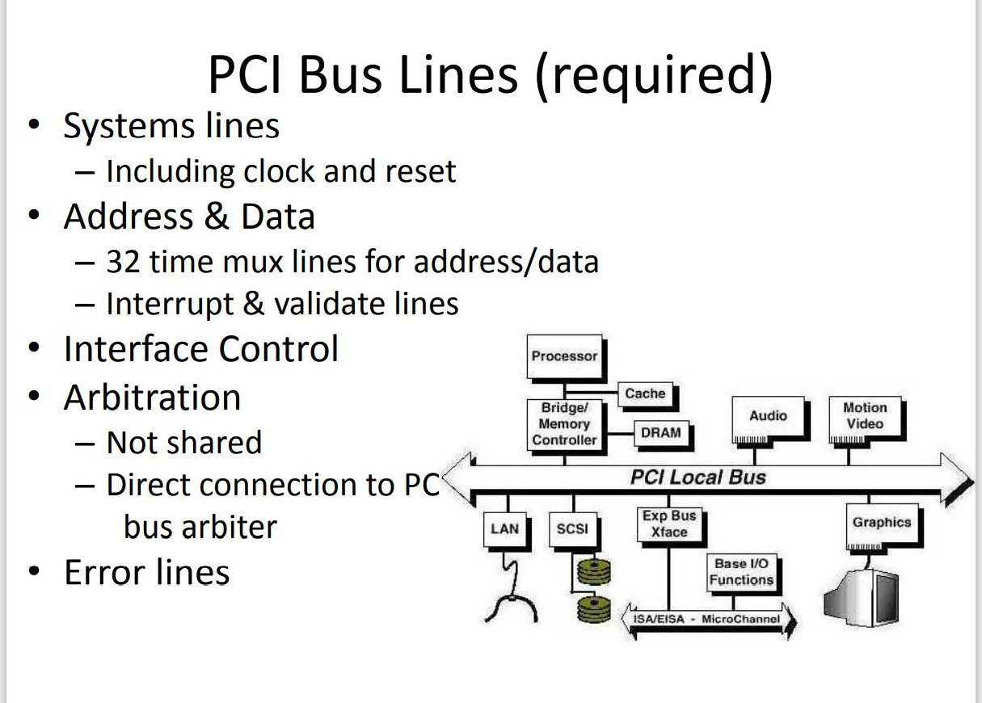
Features PCI Bus

Slide 10
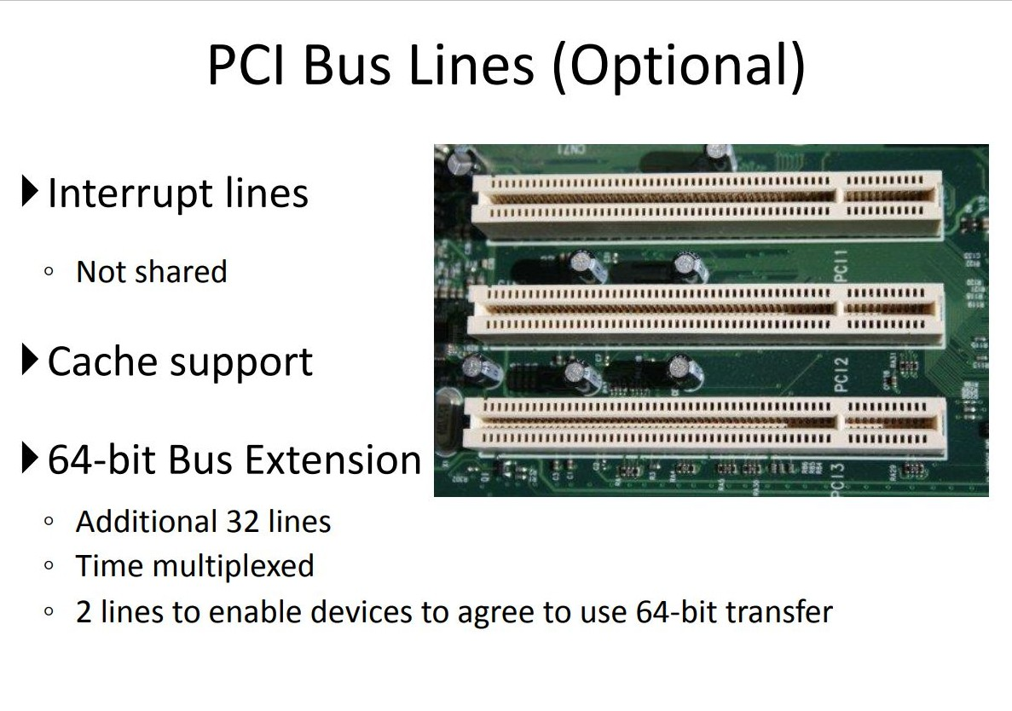

Slide 11
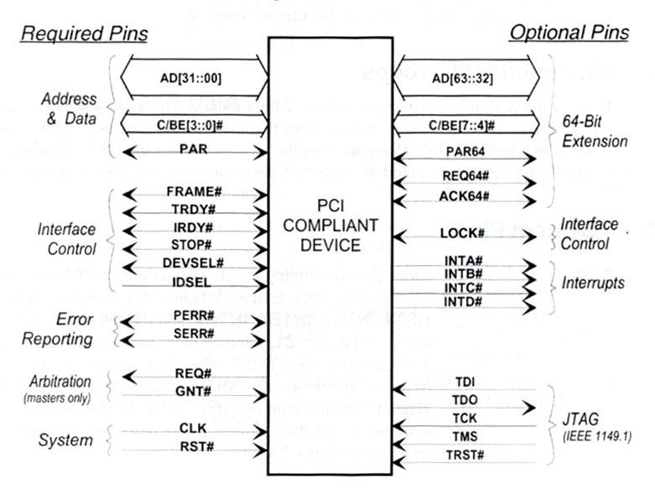
Features PCI Bus

Slide 12
SCSI Bus
Fast bus that can connect lots of devices to a computer at the same time, including hard drives, scanners, CD-ROM/RW drives, printers and tape drives
Helps to put multiple items on one bus.
Also works with most computer systems.
Problems
Limited BIOS support
Has to be configured for each computer
No common SCSI software interface
All different types of SCSI have different speeds,bus widths,connectors

Slide 13
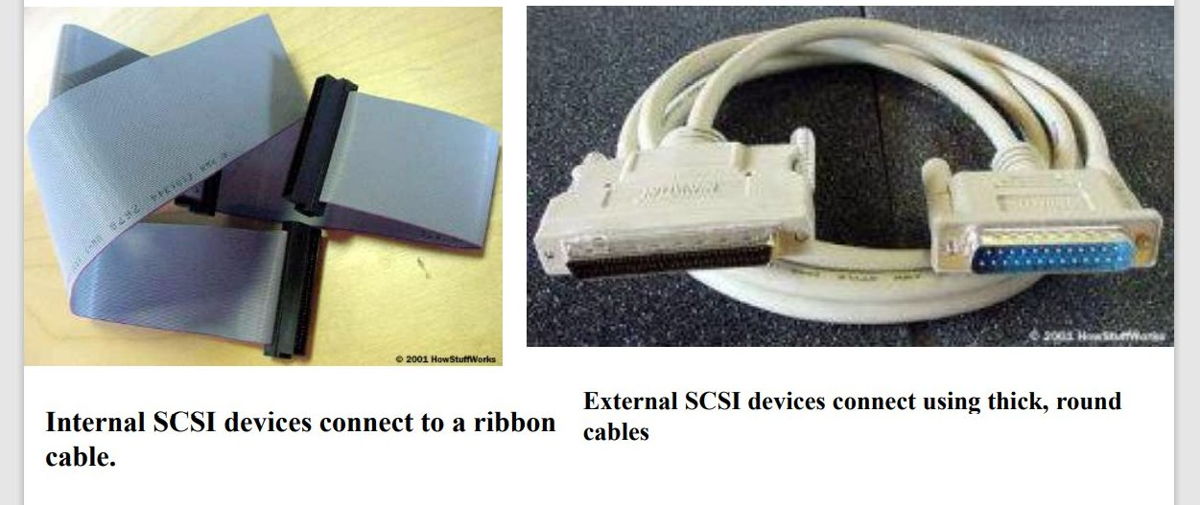
SCSI Bus

Slide 14
SCSI Bus
How many devices can be connected to SCSI controller?
What is data transfer rate?
Is the data transfer synchronous or asynchronous?
SCSI Phases
Arbitration : distributed arbitration
Selection
Information transfer
Reselection

Slide 15
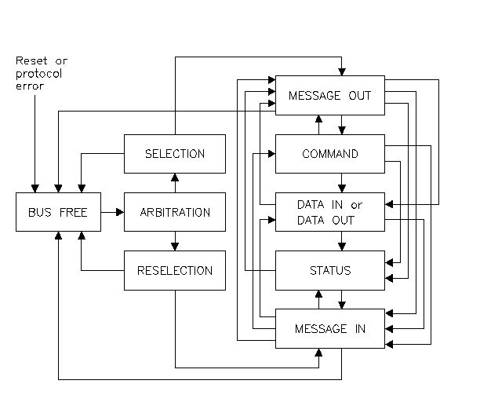
SCSI Phases

Slide 16
SCSI Bus
Category | Signals | Functions
Data | DB0 -DB7 , DB (p) | Data during information transfer, device identification during arbitration / selection phase
Phase | BSY, SEL | Indication of Bus free, Selection / reselection phase
Information Type | C/D#, MSG | Control , Data or Message
Handshake | REQ, ACK | Request for data transfer by target, Ack for data transfer completion by initiator
Direction of Transfer | I/O | Direction of data transfer with respect to initiator
Other | ATN, RST | Attention by Initiator for sending message, Reset to reset system

